Slide 1

Sprocket Central Pty Ltd
Data analytics approach
Shwetabrata Basu Ray

Slide 2
Agenda
Introduction
Data Exploration
Model Development
Interpretation

Slide 3
Introduction
Identified & Recommended High Value Customers
Outline of Problem
Sprocket Central Pty Ltd is a company specialize in high-quality bike and accessories.
The marketing team is looking to boost the sales.
To target 1000 new customer that will bring the highest value to the business.
Approach For Data Analysis
Bike Related purchases for the last 3 years made by gender.
Wealth segment by Revenue.
Highest number of customers by job industry.
Most purchases made by age group.
Customers who owns cars by state.

Slide 4
Data Quality Assessment :-
Data Exploration
Key issues dealt with for the data quality issue
Sheet Name |  | Column Name |  | Error |  | Reason
Transactions |  | Online Orders |  | Completeness |  | Null Values
 |  | Brand |  | Completeness |  | Null Values
 |  | Product first sold date |  | Relevancy |  | To convert from Integers to Date
New Customer List |  | Gender |  | Consistency |  | We found that many row had irrelevant Values
 |  | DoB |  | Completeness |  | We found many date doesn't had correct values
 |  | Job Title |  | Completeness |  | Null Values
 |  | Job Industry Category |  | Completeness |  | Null Values
 |  | Postcode |  | Validity |  | Some values were not assigned with correct data type
 |  | property_valuation |  | Validity |  | Some values were not assigned with correct data type
Customer Demographic |  | Gender |  | Consistency |  | U - irrelevant value, (Male, Female, Femle) converted to M and F
 |  | Job title |  | Completeness |  | Null Values
 |  | Job industry |  | Completeness |  | Null Values
 |  | Deceased indicator |  | Completeness |  | Y - its irrelevant
 |  | default |  | Relevancy |  | Unknown Values
Customer Address |  | State |  | Consistency |  | (New South, Wales, Victoria) converted to NSW and VIC

Slide 5
Data Exploration
Bike related purchase over the last 3 years based on gender.
Data shows, on an average females have more bike related purchase than males.
On average female have had 1% higher bike related purchases compared to men in the last 3 years.

Slide 6
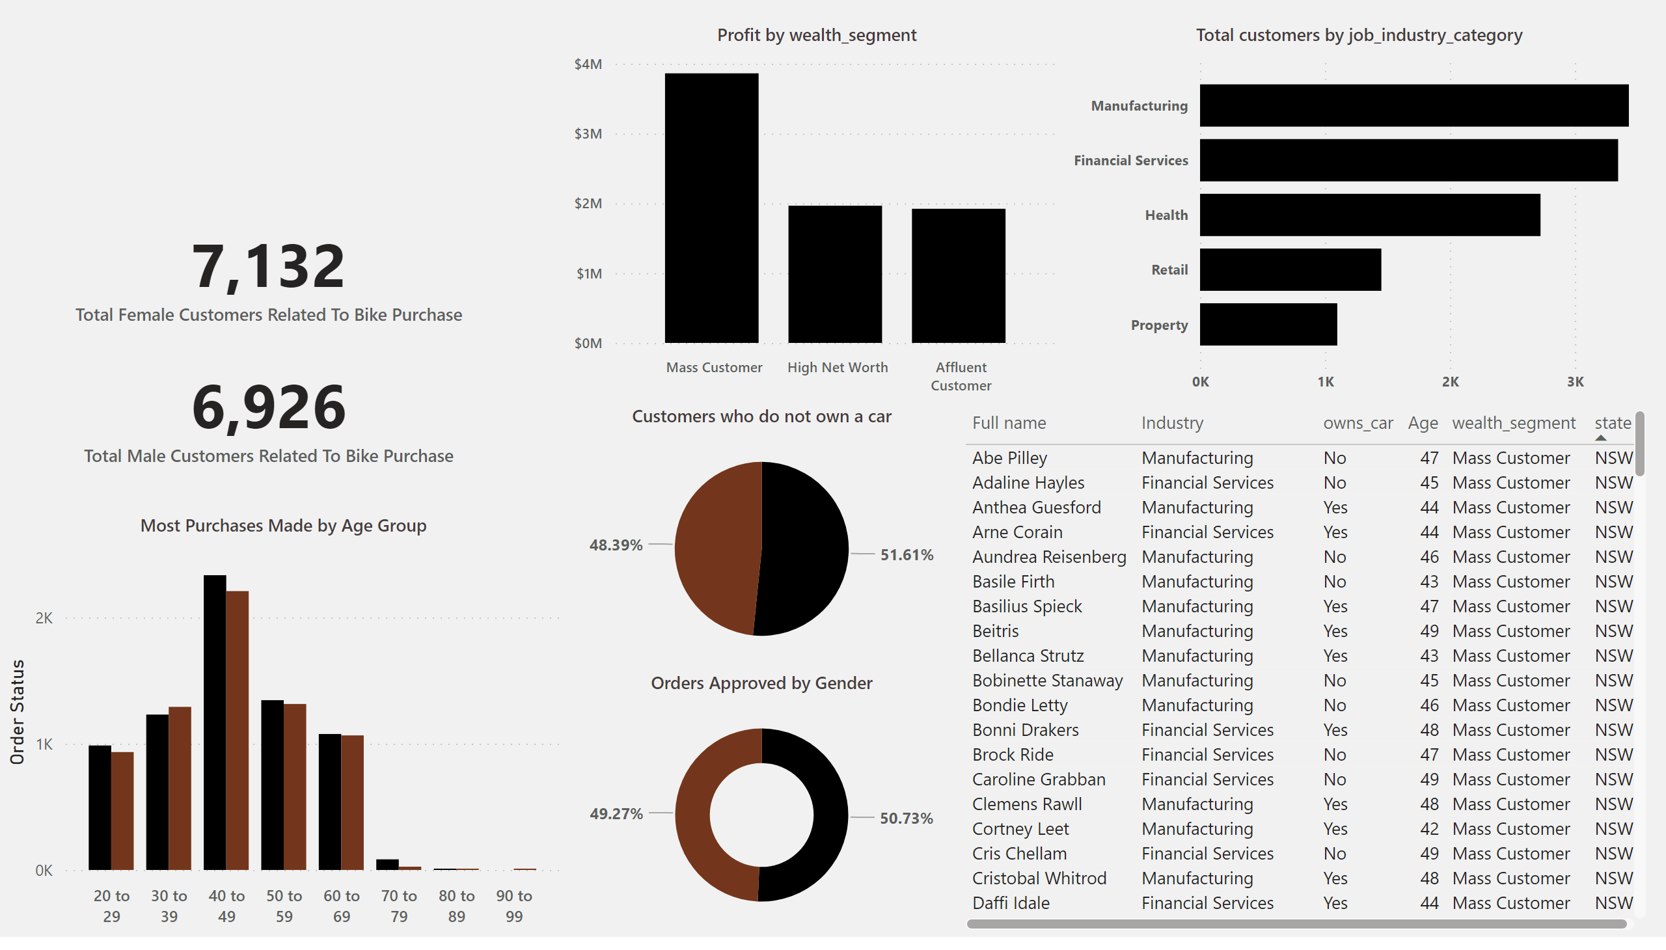
Data Exploration
Wealth Segment by Revenue
Data shows Mass customer segments drives the most revenue in the wealth segment.
There is a gape of nearly $2M between High Net Worth and Mass customer segment.

Slide 7
Data Exploration
Highest number of customers by job industry.
Data shows Manufacturing, Financial Services, Health industry have the most number of customers.
The marketing team should not care much about the retail and property industrial customers

Slide 8
Data Exploration
Most purchases made by age group.
Black is denoted as Female and brown is denoted as Male.
We can see that the people between the age group of 40 to 49 is making the most amount of purchases .

Slide 9
Data Exploration
Customers who owns cars by state.
From the Visual we can derive that NSW, VIC customers has the most number of cars owned so we will be giving more focus on them.
In further analysis we will not be taking QLD into consideration as it seams the buying potential is less over there.

Slide 10
Model Development
These are the high value customers that should be targeted from the new list:
Most of the high value customers will be female compared to male
Belonging to the Mass customer segment,
Working in the manufacturing, financial service and health industrial sector,
aged between 40 -49
who are currently living in NSW, VIC

Slide 11

Interpretation
Summary Table for High Value Customers
Here is a snapshot of few customer that will come under the high value customer clarification:

Slide 12
Thank You

